Slide 1
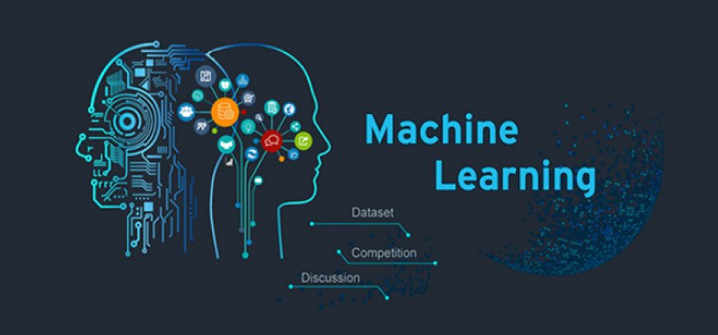
This Photo by Unknown Author is licensed under CC BY-SA

Slide 2

AI-Based Fleet Performance & Risk Prediction System
MetroMove Transit Service

Slide 3
Christopher F. Ogbechie
Lukman Ibrahim
Matthew Asare
Machine Learning ANLT202
December 12, 2025.

Slide 4

Business Problem
Frequent trip delays
High and unpredictable maintenance costs
Unsafe driving behavior
Lack of data-driven decision tools

Slide 5
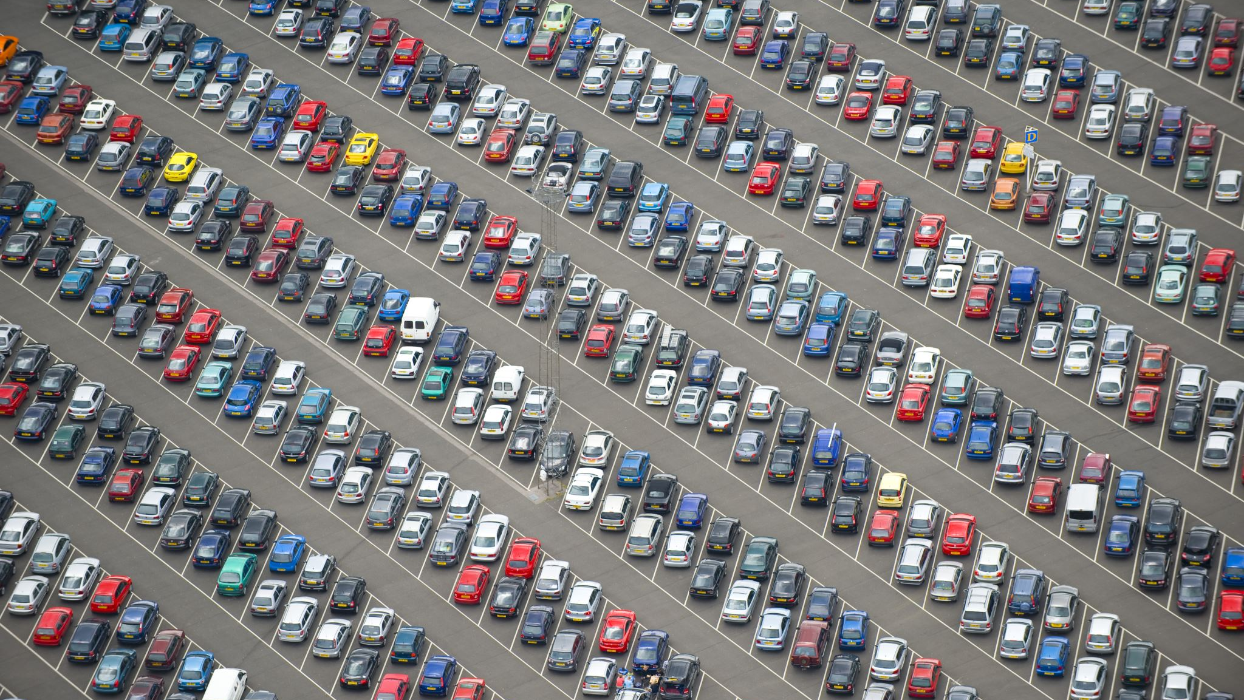
Project Objectives
Predict high-risk (delayed) trips
Predict vehicle maintenance cost
Compare ML vs Deep Learning models
Deploy a cloud-based prediction app

Slide 6
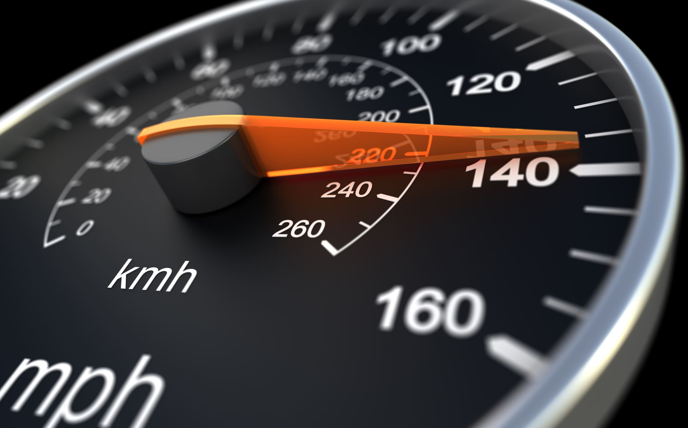
Dataset Overview
Source: Kaggle Fleet Dataset
5,000 trip records
Vehicle, GPS, cost, behavior, and time features
No missing values

Slide 7
Machine Learning Tasks
Classification
Predict delayed vs normal trips
Target: status → high-risk
Regression
Predict maintenance cost
Target: maintenance cost

Slide 8

Models Used
Classification
Logistic Regression
Random Forest
Balanced Logistic Regression
Deep Learning (Neural Network)
Regression
Linear Regression
Random Forest Regressor

Slide 9
Key Results
Baseline models failed due to class imbalance
Balanced Logistic Regression:
~47% recall on delayed trips
Deep learning did NOT outperform ML
Regression performance limited due to weak predictors

Slide 10

Cloud Deployment
Built with Streamlit
User inputs trip details
Predicts:
  Risk level
  Maintenance cost
Public web access
Link (small text):
https://ai-fleet-demand-metromove-08qov4sdpgtreftqbj6ysu.streamlit.app/

Slide 11

Conclusion & Future Work
ML improves fleet decision-making
Balanced models handle risk better
Deep learning requires richer data
Future improvements:
  Real-time telemetry
  Time-series forecasting
  Advanced dashboards

